Slide 1
Listing Rating in NYC Airbnb
IEOR 4650-002 Project
Presented by: Jiyin Chen, Xinyi Lin, Gaole Lyu, Yifan Xia & Yifei Zhu

Slide 2


Introduction
What inspired us?
Understanding what customer value is crucial for guiding business decisions, marketing initiatives, etc.
Main goal?
Analyze and obtain the key factors that impact the review score rating of a listing house to help the company understand customers’ picks.
Approach?
Data obtained from Airbnb Open Data and analyzed in R.

Slide 3
Data Cleansing
We start with 74 columns
Step 1: Change all the “True” or “False” values from “t”/“f” to 1/0.
Step 2: Handle N/A, either replace N/A with values that are consistent with column content or remove the entire row.
Step 3: Remove superfluous words and symbols.
Step 4: For amenities and host_verifications, replace texts with list length and convert values to numeric.
Step 5: Generate new column “review_duration” based on first and last review time.
Step 6: Remove all the other unwanted columns.
Notes:
3

Slide 4
Data Cleansing
We start with 74 columns
Step 1: Change all the “True” or “False” values from “t”/“f” to 1/0.
Step 2: Handle N/A, either replace N/A with values that are consistent with column content or remove the entire row.
Step 3: Remove superfluous words and symbols.
Step 4: For amenities and host_verifications, replace texts with list length and convert values to numeric.
Step 5: Generate new column “review_duration” based on first and last review time.
Step 6: Remove all the other unwanted columns.
host_is_superhost
host_has_profile_pic
host_identity_verified
has_availability
instant_bookable
Notes:
4

Slide 5
Data Cleansing
We start with 74 columns
Step 1: Change all the “True” or “False” values from “t”/“f” to 1/0.
Step 2: Handle N/A, either replace N/A with values that are consistent with column content or remove the entire row.
Step 3: Remove superfluous words and symbols.
Step 4: For amenities and host_verifications, replace texts with list length and convert values to numeric.
Step 5: Generate new column “review_duration” based on first and last review time.
Step 6: Remove all the other unwanted columns.
host_response_time
N/A → “a few days or more”
host_response_rate
host_acceptance_rate
N/A → 0; remove all ‘%’
Strings → numeric
price
Remove all ‘$’
Strings → numeric
Notes:
5

Slide 6
Data Cleansing
We start with 74 columns
Step 1: Change all the “True” or “False” values from “t”/“f” to 1/0.
Step 2: Handle N/A, either replace N/A with values that are consistent with column content or remove the entire row.
Step 3: Remove superfluous words and symbols.
Step 4: For amenities and host_verifications, replace texts with list length and convert values to numeric.
Step 5: Generate new column “review_duration” based on first and last review time.
Step 6: Remove all the other unwanted columns.
bathrooms_text
bedrooms
beds
N/A → 0 or “0 baths”
Treat all half baths as 0.5 bath (Private/Shared /just half-bath)
Remove all text modifiers
Strings → numeric
Notes:
6

Slide 7
Data Cleansing
We start with 74 columns
Step 1: Change all the “True” or “False” values from “t”/“f” to 1/0.
Step 2: Handle N/A, either replace N/A with values that are consistent with column content or remove the entire row.
Step 3: Remove superfluous words and symbols.
Step 4: For amenities and host_verifications, replace texts with list length and convert values to numeric.
Step 5: Generate new column “review_duration” based on first and last review time.
Step 6: Remove all the other unwanted columns.
host_response_rate
price
host_total_listings_count
review_scores_rating
review_scores_accuracy
review_scores_cleanliness
review_scores_checkin
review_scores_communication
review_scores_location
review_scores_value
Remove all rows that contain empty or N/A values in any of these fields
Notes:
7

Slide 8
Data Cleansing
We start with 74 columns
Step 1: Change all the “True” or “False” values from “t”/“f” to 1/0.
Step 2: Handle N/A, either replace N/A with values that are consistent with column content or remove the entire row.
Step 3: Remove superfluous words and symbols.
Step 4: For amenities and host_verifications, replace texts with list length and convert values to numeric.
Step 5: Generate new column “review_duration” based on first and last review time.
Step 6: Remove all the other unwanted columns.
amenities
host_verifications
— Values in list-like format
Loop and count the numbers
Original values → counted numbers
Strings → numeric
Notes:
8

Slide 9
Data Cleansing
We start with 74 columns
Step 1: Change all the “True” or “False” values from “t”/“f” to 1/0.
Step 2: Handle N/A, either replace N/A with values that are consistent with column content or remove the entire row.
Step 3: Remove superfluous words and symbols.
Step 4: For amenities and host_verifications, replace texts with list length and convert values to numeric.
Step 5: Generate new column “review_duration” based on first and last review time.
Step 6: Remove all the other unwanted columns.
first_review
last_review
— Compute difference to indicate duration length
last_review data minus first_review data
Divide the resulting number by 365
New column, review_duration
Remove first_review and last_review
Notes:
9

Slide 10
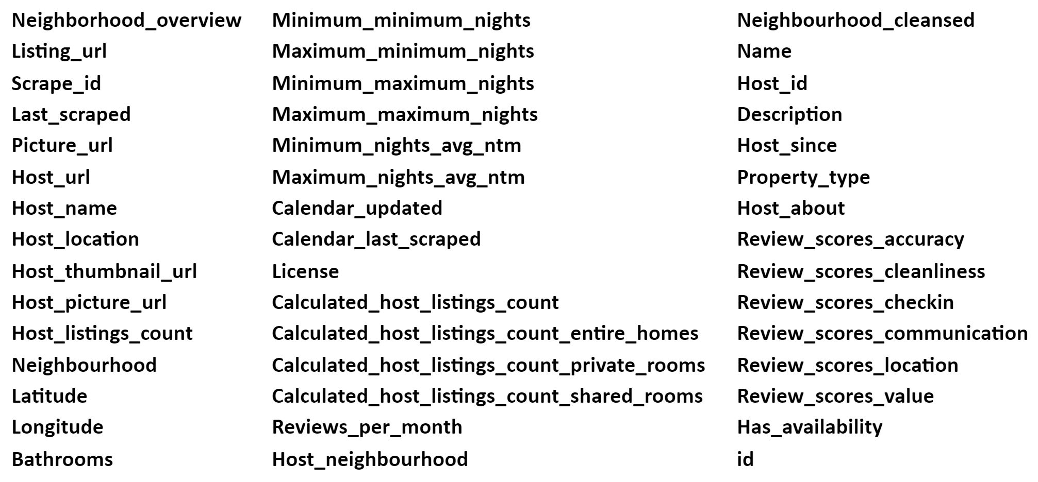
Data Cleansing
We start with 74 columns
Step 1: Change all the “True” or “False” values from “t”/“f” to 1/0.
Step 2: Handle N/A, either replace N/A with values that are consistent with column content or remove the entire row.
Step 3: Remove superfluous words and symbols.
Step 4: For amenities and host_verifications, replace texts with list length and convert values to numeric.
Step 5: Generate new column “review_duration” based on first and last review time.
Step 6: Remove all the other unwanted columns.
45 columns removed in total
Double check whether there is still any column that contains N/A: no more such columns
Notes:
10

Slide 11
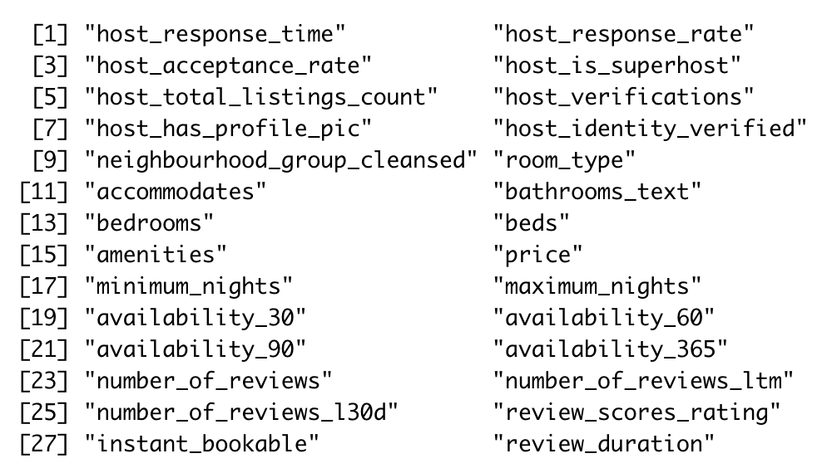
Data Cleansing
We start with 74 columns
Step 1: Change all the “True” or “False” values from “t”/“f” to 1/0.
Step 2: Handle N/A, either replace N/A with values that are consistent with column content or remove the entire row.
Step 3: Remove superfluous words and symbols.
Step 4: For amenities and host_verifications, replace texts with list length and convert values to numeric.
Step 5: Generate new column “review_duration” based on first and last review time.
Step 6: Remove all the other unwanted columns.
> Resulting 28 variables as our primary factors
Notes:
11

Slide 12
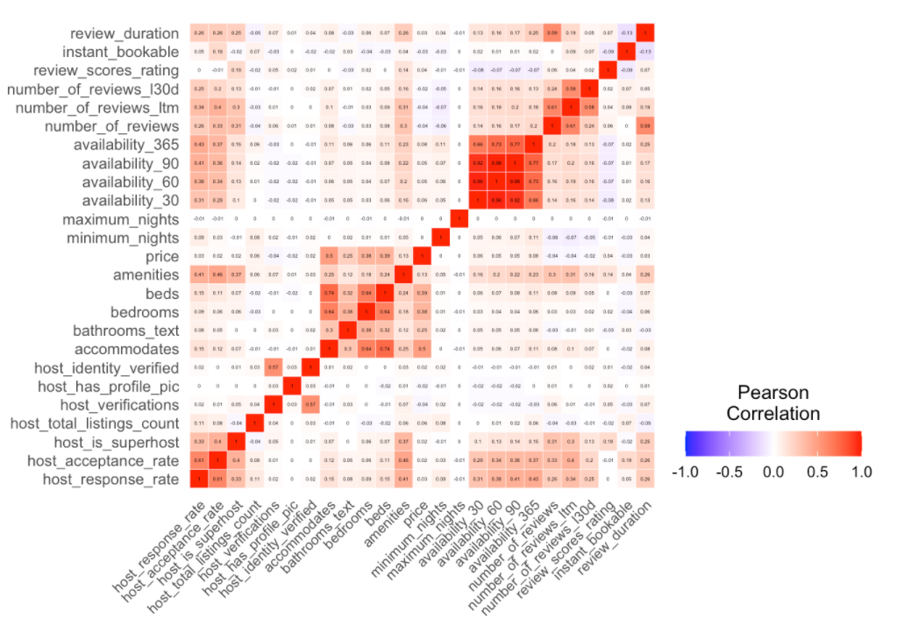
Exploratory Data Analysis
Correlation Heatmap among all variables

Slide 13
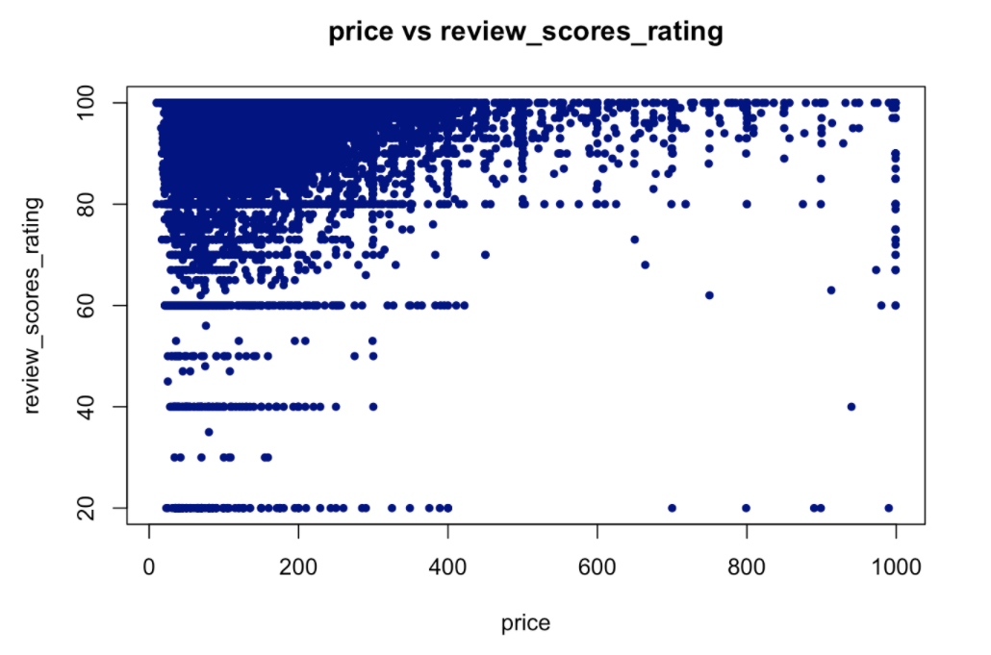
Exploratory Data Analysis Continued
Relationship between covariates and dependent variable RSR (review score rating)
Price vs RSR
the distribution of a continuous covariate that skews toward the upper corner.

Slide 14
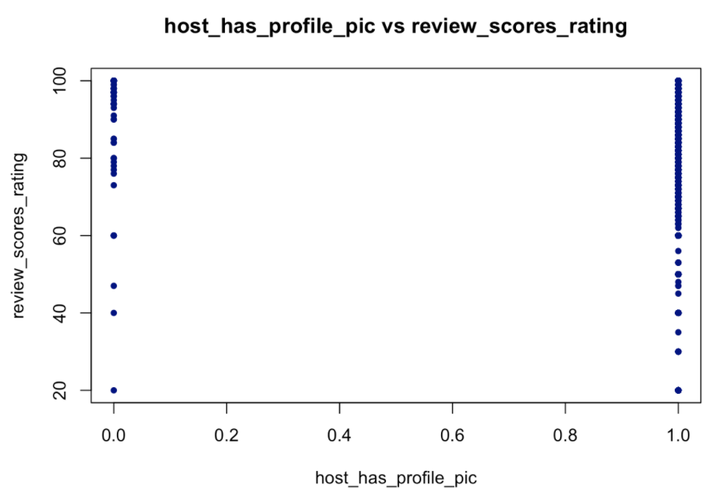
Exploratory Data Analysis Continued
Relationship between covariates and dependent variable RSR (review score rating)
Hosts with profile pics vs RSR
a dummy variable which distributes differently at 0 and 1

Slide 15
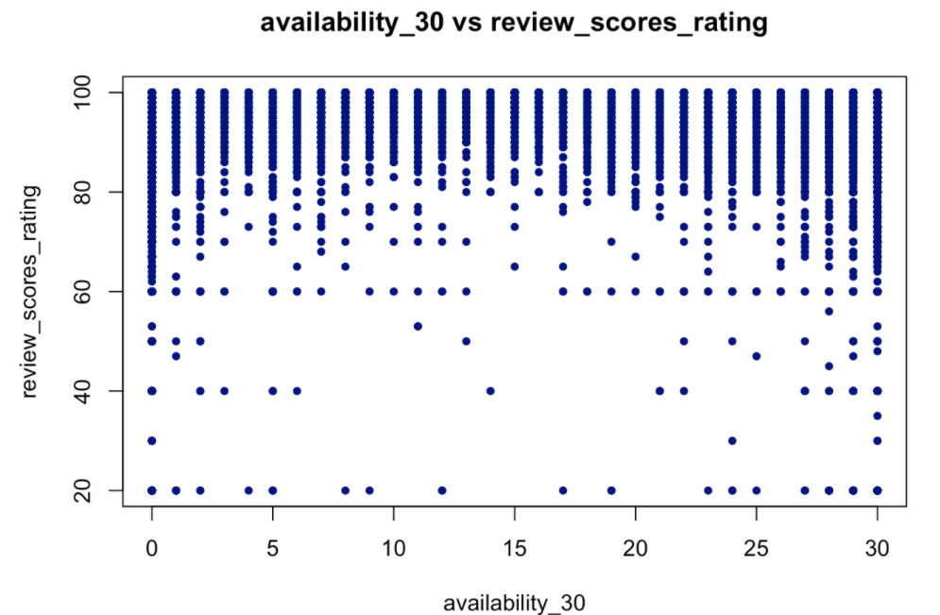
Exploratory Data Analysis Continued
Relationship between covariates and dependent variable RSR (review score rating)
Availability_30 vs RSR
a relatively even spread of a discrete variable

Slide 16
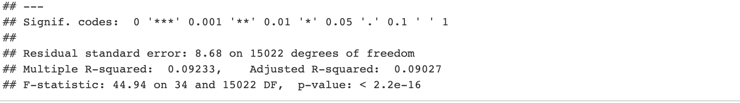
II. Multi-regression analysis + Lasso
50% Data as training set ; 25% as validation set; 25% as test set
P-value of the regression model is less than 2.2e^-16
Adjusted R-squared is 0.09027

Slide 17
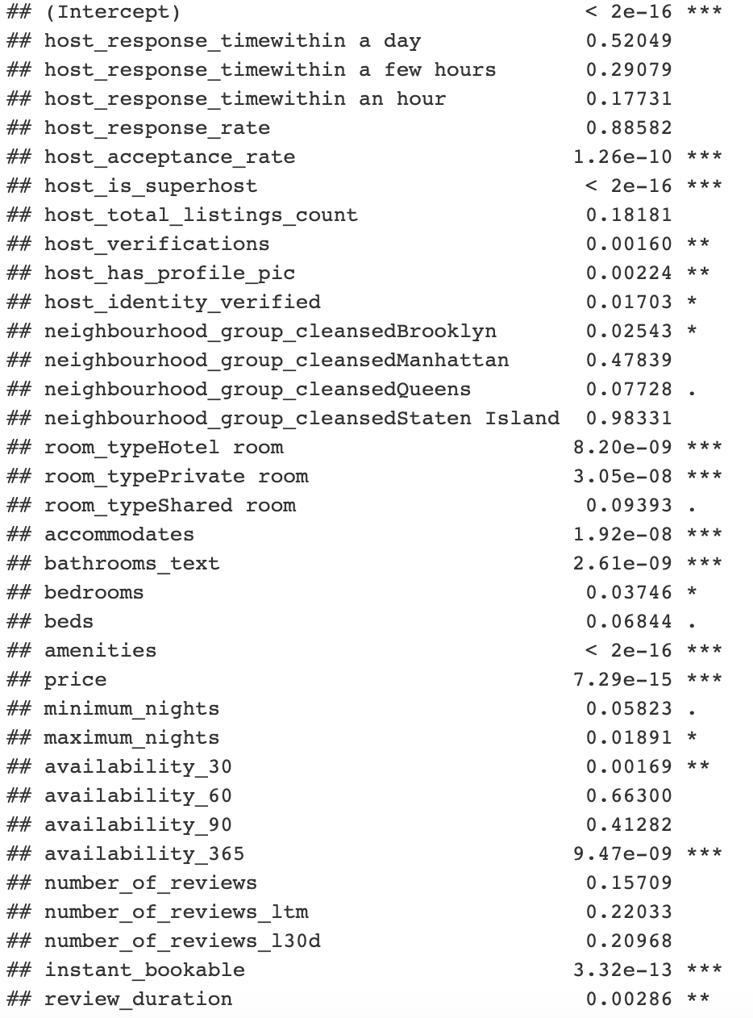
II. Multi-regression analysis + Lasso
P-value obtained from a multiple linear regression model based on training set
Most significant: amenities, host_is_superhost, accommodates

Slide 18
II. Multi-regression analysis + Lasso Continued
Lasso as the best parameter selection
overly computationally intense to use best subset selection
the number of observations is far greater than the number of predictors
only a few variables are highly correlated (beds & bathrooms, availbility_365 & availbility_90 & availbility_60 & availbility_30) and none of them are highly collinear

Slide 19
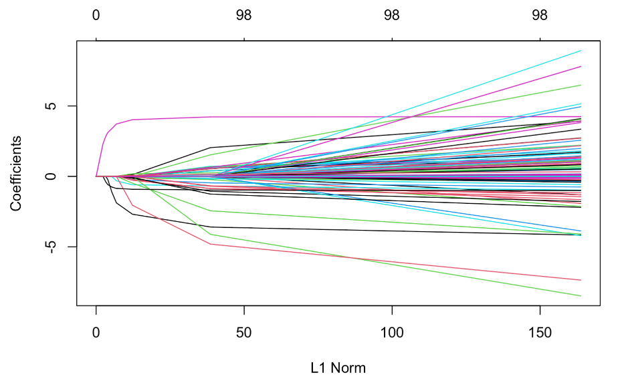
II. Multi-regression analysis + Lasso Continued
L1 norm of zero gives an empty model, and as one increases the L1 norm, variables will "enter" the model as their coefficients take non-zero values

Slide 20
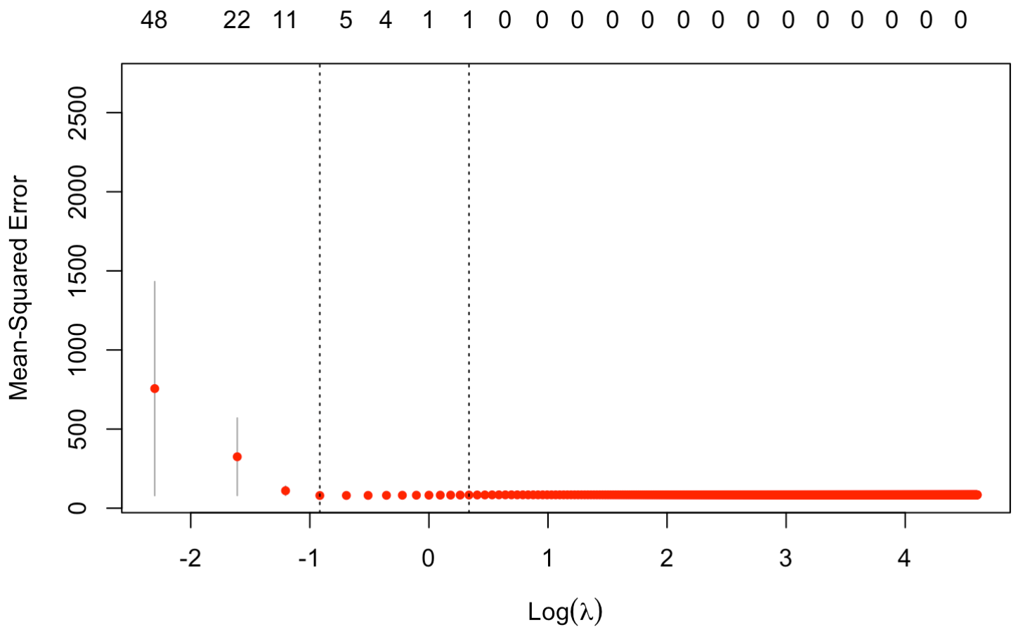
II. Multi-regression analysis + Lasso Continued
we tried 1000 lambda values:
0.1, 0.2, …, 99.9, 100
log-lambda with the smallest MSE located around -1
best lambda = 0.4

Slide 21
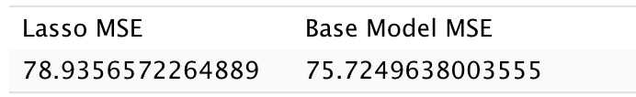
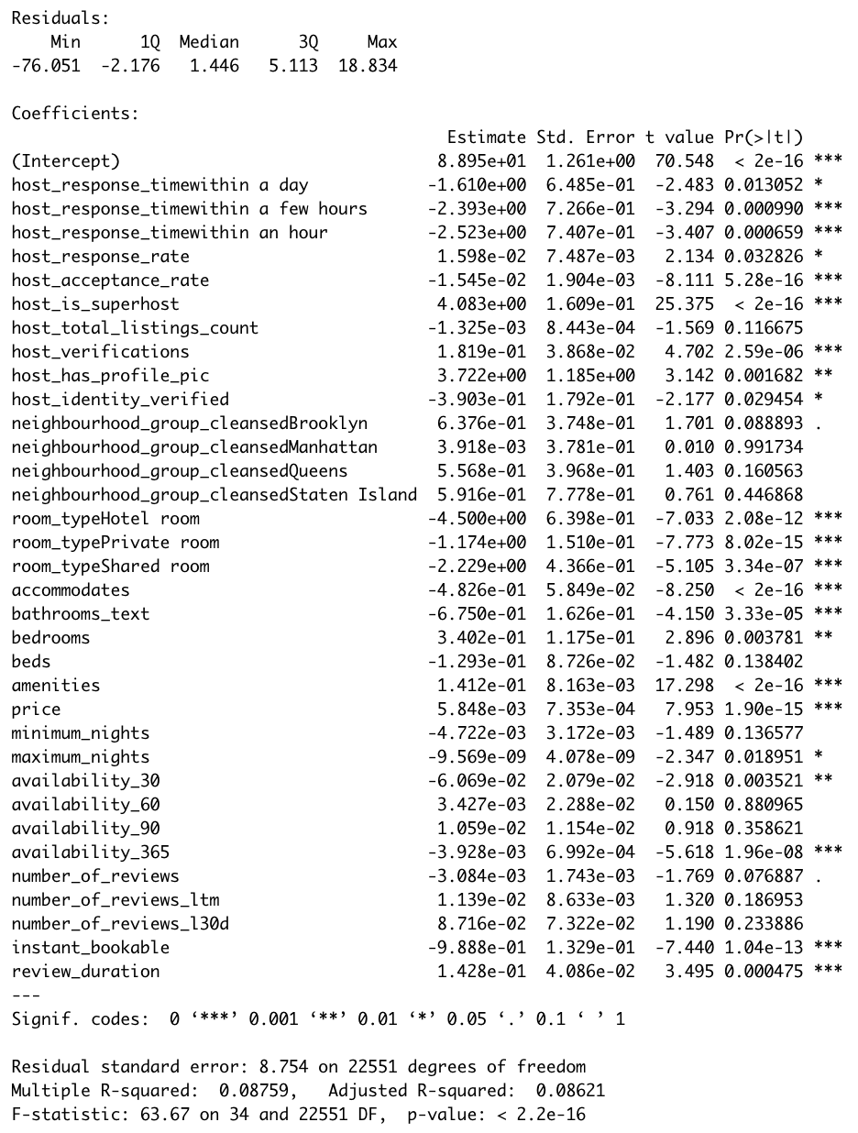
III. Result
Prediction MSE on test data is 82.26686.

Slide 22
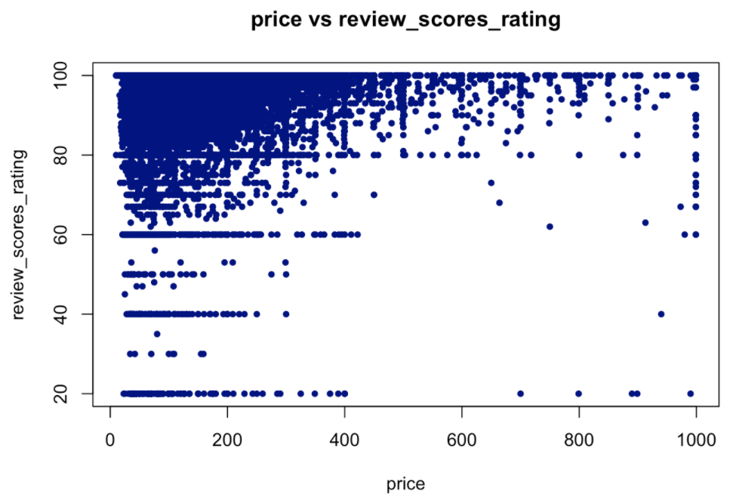
IV. Conclusion
Price in middle range:
Less Lower review_scores_rating
Price outside of middle range:
Relatively more low review scores rating
Hosts need to be more careful when they serve guests

Slide 23
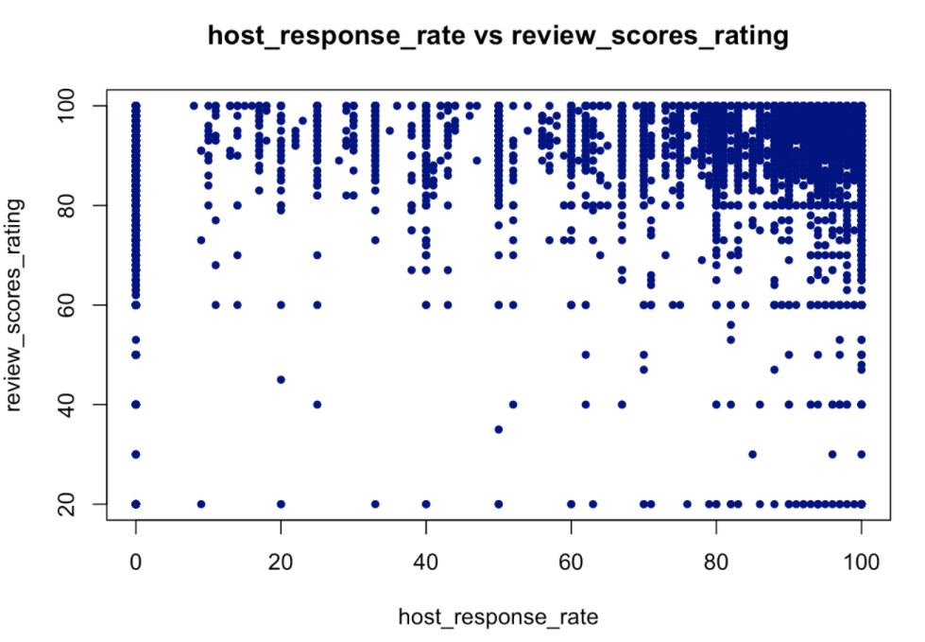
IV. Conclusion Continued
Higher host response rate:
Bigger range of scores rating
Interact with guests while in a more thoughtful manner
dfjsk

Slide 24

IV. Conclusion Continued
Recommendation:
Actively promote the benefits of obtaining a superhost badge

Slide 25
Reference
The dataset we use: reviews.csv.gz, under the category “New York City, New York, United States”, with 05 October, 2020 as “Date Compiled”, through link: http://insideairbnb.com/get-the-data.html.

Slide 26


Thank you
Any Questions?
TRANSCENDING DISCIPLINES, TRANSFORMING LIVES

Slide 27


